Slide 1
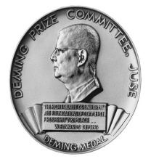
Unit TQ 001 / Section 1 / Understanding ‘Quality’
What is TQM for
Business Executives
Press the down arrow below to continue
1/29

Slide 2
Business Executives/ Understanding ‘Quality’
Welcome
This programme is intended for organisations whose business objectives are to become and remain the best in class whatever their field of operation.
This programme has been designed exclusively for Business Executives who are each responsible for the management of all functions in an organisation whether it be Finance, Marketing, Sales, Operations, R&D, After Sales etc.
Press the down arrow below to continue
1/29

Slide 3

Business Executives/ Understanding ‘Quality’
Our Credibility
This programme was designed by our Principal David Hutchins – winner of the business equivalent of the Hollywood Oscars the ‘Deming Distinguished Practice Award’.
David is the only Westerner to win this version of the coveted Award. It was awarded to him for successfully implementing programmes founded on the same principles as those adopted by the Gold Star Club and it is our intention in this club to assist organisations progressively work towards being eligible for consideration for the International Company version of this highly prized award.
Press the down arrow below to continue
1/29

Slide 4
Business Executives/ Understanding ‘Quality’
The objectives of the DHI approach
Objective:
To help our members to build organisations in which each individual employee is developed to become the expert in his or her own job at all levels.
The object of this is then to be able to use the collective thinking power of all employees to make their organisation the best in its business and to bring out man’s infinite capabilities.
Everyone has undiscovered talents not only unknown to the organisation but also in many cases, even to the participants themselves.
Maybe you are somewhere like here now?
Gold Star Performer
Management by process - High performance process output
Management by function - Low performance process output
The Gold Star Club
helps you get from
The state on the left-----to here on the right?
Press the down arrow below to continue
1/29

Slide 5
Business Executives/ Understanding ‘Quality’
Maybe nobody is right over here!
Maybe you are here?
Gold Star Performer
Maybe your competitor is here?
Maybe nobody is right over here either
Both improving!
The Gold Star Club
helps you get from
The state on the left-----to here on the right?
Press the down arrow below to continue
1/29

Slide 6
Business Executives/ Understanding ‘Quality’
Maybe you are here?
Maybe your competitor is here?
Both improving!
So, you are both improving and right now you seem to be ahead!
Looks good BUT!!
It is the rate of improvement that counts. Check the next slide
Press the down arrow below to continue
1/29

Slide 7
Business Executives/ Understanding ‘Quality’
So, if you are lucky, maybe you are ahead right now? No room for complacency. Supposing that your competitor has you in his/her sights?
They go up a steeper slope than you. So the gap narrows until it closes!
Maybe you have been ahead for a long time and are not benchmarking your competitors? So, you do not notice it until it is too late!
If you then want to recover your previous position you will have to go up an even steeper slope than them! Could be difficult. The structure that we will help you create will enable you to ensure that that never happens.
Business Performance
You
Your Competitor
Break even!
Time
Press the down arrow below to continue
1/29

Slide 8
Business Executives/ Understanding ‘Quality’
The word ‘Quality’
Whatever your preconceptions of the meaning of this word we recommend that you shelve it until you have finished with this Unit. It is more important than you might think right now.
It is highly likely that you might see it differently having worked through the concepts included.
We recommend that you discuss it with your colleagues
Press the down arrow below to continue
1/29

Slide 9
Business Executives/ Understanding ‘Quality’
The key topics covered in this programme are :-
1. What actually is ‘Quality’
2. Who is responsible for ‘Quality’
3. Why a ‘Quality Manager’ – do we really need one?
4. Role of the Quality Manager
5. Expectations of the Quality Manager
6. Specific definitions of Quality
7. Some additional Definitions of Quality
Press the down arrow below to continue
2/29

Slide 10
Business Executives/ Understanding ‘Quality’
Method of working – our recommendation
We recommend that following the seminar each individual executive works through these materials again independently but, maybe also add this topic to the agenda of your regular Management meetings.
At the end of the programme there is a Quiz included.
Work through this material on your own but also go through the questions in the quiz at an executive meeting all together. Consensus is important.
Press the down arrow below to continue
2/29

Slide 11
Business Executives/ Understanding ‘Quality’
What actually is Quality?
This is a good question and one that even quality ‘experts’ debate all the time. In the Western World, thoughts immediately turn to conformance, standardisation and ISO 9000. You will see later that there is far more to it than that.
The fact is that it is contextual. In other words, the meaning changes slightly according to the situation.
It would be quite reasonable to say ‘I cannot define Quality’ but I know it when I see it. It is the same with all judgmental terms such as ‘nice’, ‘beautiful’, ‘excellent’, ‘love’, ‘noisy’ etc.
We all use the word ‘Quality’ in our everyday lives but rarely think about its meaning.
For example, if you went to the cinema last night and someone asks you what you thought of the film – you would without thinking, give a qualitative answer.
‘yes, I really liked it’ or maybe ‘awful, we did not stay to the end’
Press the down arrow below to continue
4/29

Slide 12

Business Executives/ Understanding ‘Quality’
What actually is Quality?
Quality really is about being perceived to be good at something. We all want to be good at something whether it is our work, a pastime, in our community or family.
If we have children, we probably want to be regarded by our children and friends as being a good mum or dad.
As a family, we want to be respected and have our opinions requested and taken seriously.
Press the down arrow below to continue
5/29

Slide 13

Business Executives/ Understanding ‘Quality’
What actually is Quality?
Quality is a source of pride, self respect and it begins early in life
‘mummy, mummy, I got a ‘gold star’! in my exercise book!
We go through life wanting to get gold stars in our exercise books!
Sadly, not everybody sees ‘Quality’ this way! If you do, then maybe you are on a winner!
Press the down arrow below to continue
5/29

Slide 14

Business Executives/ Understanding ‘Quality’
Who is responsible?
Who is responsible for Quality?
Regardless of who is reading this, the probability is, if you are resident in the Western Hemisphere that your perception is that ‘Quality’ is the responsibility of the ‘Quality Manager’ or if not then someone who has the management of ‘Quality’ in their job description.
If this is the case then, whilst we understand why you might think it, in fact you couldn’t be more wrong. Why?
Having a Quality Manager is a good way of passing the buck!
Press the down arrow below to continue
3/29

Slide 15

Business Executives/ Understanding ‘Quality’
What actually is Quality?
If we participate in team sport we want to be selected, we want to play well. We want to get on well with our fellow players and collectively we all want to win but! To do that we soon learn that we are mutually dependant. We cannot do it on our own!.
If it is an individual sport such as cycle time trialling or track athletics, we might still want to be selected and be part of a team but our build up and training is often down to us or us and possibly our coach advising us.
Press the down arrow below to continue
6/29

Slide 16
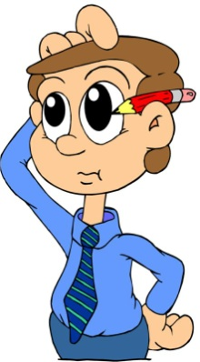
Business Executives/ Understanding ‘Quality’
What actually is Quality?
Quality is all of the above, trying to do our best, knowing what is regarded to be ‘good’, knowing our own performance, having the means to check our own performance against some standards and then making improvements where we see the opportunity.
So, ‘quality’ is just as important outside of work in our private lives as it is in our work. There is no real difference provided that we are given the education, training and empowerment to be able to make a difference.
Quality in your workplace
Before moving on, just think about the work you do and ask yourself, “is there something that I would like to be seen as being better at and I would like recognition for”? It does not have to be anything big. Even the very small things are important especially if they make us feel better.
Press the down arrow below to continue
7/29

Slide 17

Business Executives/ Understanding ‘Quality’
What actually is Quality?
If we are bidding for a contract, we are up against others who are as determined to win it as you are.
What are their strengths and weaknesses compared with ours?
How might we equal or surpass their strengths? How might we exploit their weaknesses?
If there are other market related issues that impact on everyone such as tariffs, border controls etc. Can we find a way of dealing with them that gives us a competitive advantage?
Press the down arrow below to continue
8/29

Slide 18


Business Executives/ Understanding ‘Quality’
What actually is Quality?
The great thing about understanding the means by which ‘quality’ can be achieved is that it can be life changing. Being the best individually and collectively is just great!
Ask the members of Team GB after they came home with their bunches of medals. This could be you and your colleagues. Maybe you could win the overseas Deming Award?. – we all want gold stars in our exercise books!
Press the down arrow below to continue
9/29

Slide 19

Business Executives/ Understanding ‘Quality’
Who is responsible?
Because regardless of who you are and whatever your role in an organisation, you are personally responsible for your own quality provided that you are given the chance. At least you are responsible for the quality of what you do. Nobody else, just you!
However, you and your co executives are, or should be, a team. Your company’s performance is dependant on your collective aspirations as a team!
Press the down arrow below to continue
10/29

Slide 20
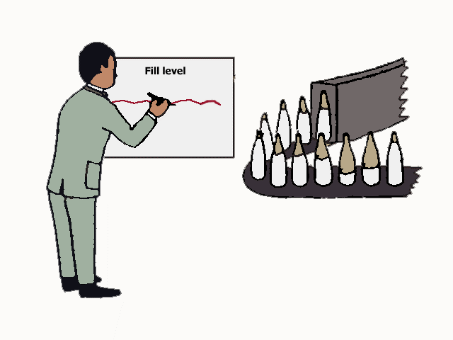
Business Executives/ Understanding ‘Quality’
Role of the Quality Manager?
What indeed if Quality actually is everybody’s business?
Well professional football teams have Managers but the managers are not kicking the ball on the field. Their job is to build the team and to assist in helping everyone on the payroll to work together to help their team to become the top in the league.
This is much the same as the job of a Football or Rugby manager.
It is not a blame game. Quality managers should be coaches not policemen.
Press the down arrow below to continue
11/29

Slide 21

Business Executives/ Understanding ‘Quality’
Why a Quality Manager?
‘Quality Management’ in Western societies is often regarded as a Police style activity – Whose fault was it? When something has gone wrong– the result is often ‘a blame culture’ in which people think that ‘Quality’ is something we whip ourselves with rather than give us a sense of pride.
This is crazy because nobody goes to work with the idea of doing a non quality job.
This is very different in parts of the Far East.
Food for thought. In our organisation, do we play the blame game? Is our Quality Department seen as a police operation or is it building and developing people and helping them to improve processes??
Press the down arrow below to continue
12/29

Slide 22

Business Executives/ Understanding ‘Quality’
Why a Quality Manager?
It was an American Dr Fiegenbaum who back in the late 1950s made the observation that ‘quality is everybody’s business. Quality Control does not hold the pencil of the designer or turn the handles on the machines.
The Japanese were quick to recognise this and saw that Quality was a ‘top down’ concept.
In their words, they said – Achieving Quality is like sweeping the stairs in which case it is best to start from the top.
In the West it has tended to be seen more like lighting a fire in which case it is best to start from the bottom.
It seems that the Japanese approach produces better results and it is the way the Gold Star Club operates.
Press the down arrow below to continue
13/29

Slide 23

Business Executives/ Understanding ‘Quality’
Why a Quality Manager?
Instead of leading Japanese companies such as Komatsu, Toyota etc appointing Quality Managers they set up Quality Councils and Quality Steering Committees with involvement from all functions and all levels.
Here is an extract from a Japanese periodical:
“In Quality Control work, all persons concerned from the President down to the operators have received suitable education and training. In one word, we have practice, so to speak, quality work of, by and for all.” Full membership of the Gold Star Club will enable your organisation to join the international front runners and enjoy the prosperity that it affords.
Press the down arrow below to continue
14/29

Slide 24
Business Executives/ Understanding ‘Quality’
Why a Quality Manager?
So, if an organisation were to adopt this approach would it mean the end of the road for the Quality Manager?
Fortunately not. This would be similar to a Premier Division football team trying to play without having an international standard Manager. Their job is to help develop the skills and strategies of each of the players, encourage team spirit, develop a sense of pride and a collective, mutually dependant desire to win. It is exactly the same as for the Quality Manager.
It will take a long time for most organisations to realign everyone's thinking and understanding of these concepts and then to practice them in the workplace.
Who is there to help them? Well, the Quality Manager can if he/she is trained to Facilitate, Coach and Mentor all people at all levels of organisation. When this programme is even only partially complete, the Quality Manager should be able to do this effectively.
The next slide provides the answers.
Press the down arrow below to continue
15/29

Slide 25

Business Executives/ Understanding ‘Quality’
Role of a Quality Manager?
Instead of being a policeman he/she converts to being trainer/mentor/coach but he/she will need training in that and the DHI course the International Diploma in Quality Leadership is designed to help achieve that but it is founded on the expectation that the relevant quality specialist will be familiar with the concepts covered in the full version of this course that you have now reviewed.
Press the down arrow below to continue
16/29

Slide 26
Business Executives/ Understanding ‘Quality’
Expectations of a Quality Manager?
In the context of this course, the following are the attributes of the qualified Quality specialist/Quality Manager:
To be respected by all levels of management from the Chief Executive through to the most basic level by his/her personality.
Caring/sharing
Good listener
Good teacher
Team builder and skilled in team dynamics
Enthusiast for what he/she is doing
Enthusiast for the achievement of the goals of the organisation
Enthusiast for people building and their personal development
Team player
Belbin* characteristics – some Shaper but not excessive, Monitor Evaluator, some Completer/Finisher
Nothing is too much trouble.
* Dr Belbin was a management scientist who specialised in identifying the characteristics of managers in winning teams. Read his book ‘Management Teams why they succeed or fail!’
Press the down arrow below to continue
17/29

Slide 27
Business Executives/ Understanding ‘Quality’
Specific definitions of Quality
Need a definition of ‘Quality’? How about write your own!
In an earlier slide we stated that ‘quality’ is contextual implying that its definition depended on the situation. Over the years many experts have attempted to define it and here are some of the suggestions.
Nearly all of the so called Quality Gurus have had their own favourites.
Dr Juran used to speak of fitness for use, for
Phil Crosby it was ‘customer satisfaction’ then there have been others such as ‘according to specification’ etc.
David Hutchins – Quality is the sparkle that separates the best from the rest!
Press the down arrow below to continue
18/29

Slide 28
Business Executives/ Understanding ‘Quality’
Specific definitions of Quality
Even today, the same arguments prevail and the differences of opinion as to a precise definition of ‘quality’ remain as unresolved as ever. We like our own:
‘quality is the sparkle that separates the best from the rest’!
We have adopted it as the mantra of the God Star Club!
The ISO 9000 standard defines quality as "degree to which a set of inherent characteristics fulfils requirement.“
Bear in mind that ‘requirement’ can vary depending upon the stated and unstated needs of each customer and these can vary so it is not that simple. We still need to conduct market research to attempt to discover their real requirements.
Press the down arrow below to continue
19/29

Slide 29
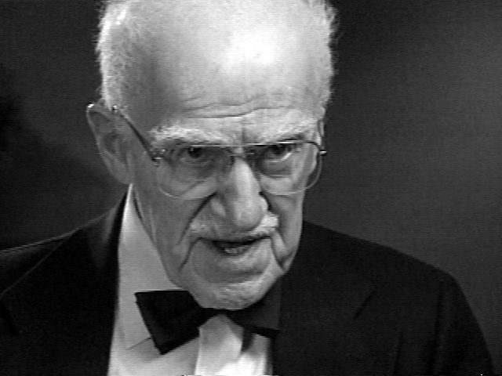
Business Executives/ Understanding ‘Quality’
Definitions of Quality
Sometime towards the end of the 1980s, Dr Juran came up with the idea of what has become known as the Big ‘Q’ and the small ‘q’.
The small ‘q’ refers specifically to each individual product or service whilst the big ‘Q’ refers to the reputation of the organisation as a whole in its market place.
For example, the reputation of say Toyota as a Corporation rather than simply the performance of its production processes. They are to some extent mutually dependant but there are many issues that impact the big Q that are not related to the small q. For example, investment policies, employment policy, marketing and sales etc. In the Gold Star Club, we deal with both the big and the small ‘Q’s. If you are an executive, think mainly about the big ‘Q’!
Press the down arrow below to continue
21/29

Slide 30
Business Executives/ Understanding ‘Quality’
Summary of learning
In this programme you will have learned:
1.
2.
3.
4.
5.
6.
7.
What ‘Quality’ actually is
Who is responsible for ‘Quality’
Why a ‘Quality Manager’
Role of the Quality Manager
Expectations of the Quality Manager
Specific definitions of Quality
Some additional Definitions of Quality.
Press the down arrow below to continue
22/29

Slide 31
Business Executives/ Understanding ‘Quality’
Quiz – please work through this both independently and then collectively
Who should be responsible for the Quality of your work?
The Quality Manager?
The Training Department?
You?
The Inspector?
Your supervisor or boss?
2. Quality is which of the following (more than one answer)?
Getting it right the first time?
Fitness for use?
Meeting customer needs?
Meeting the requirements of the specification?
Press the down arrow below to continue
23/29

Slide 32
Business Executives/ Understanding ‘Quality’
Quiz
3. Quality is important because? (may be more than one answer).
It helps you win?
Gives us a good reputation?
Makes everyone feel good?
4. Which is the most important of the following?
a) Doing better than my colleagues?
b) Finding the best way of doing things?
c) Help people do a better job?
Press the down arrow below to continue
24/29

Slide 33
Business Executives/ Understanding ‘Quality’
Quiz
5. Which is the most important of the following?
a) Doing better than my colleagues?
b) Finding the best way of doing things?
c) Cutting costs
Press the down arrow below to continue
25/29

Slide 34
Business Executives/ Understanding ‘Quality’
Quiz
6. We need Quality Managers to
Find defects
See who is to blame for faults
Help people do a better job
7. Is the following statement true or false?
In Japan the Quality manager is responsible for Quality
True
False
Press the down arrow below to continue
26/29

Slide 35
Business Executives/ Understanding ‘Quality’
Quiz
8. Quality Councils are most likely to be found in
Japan
The West
9. It is best that the Quality Manager acts as
A Coach
A policeman
Press the down arrow below to continue
27/29

Slide 36
Business Executives/ Understanding ‘Quality’
Quiz
10. The big ‘Q’ is
A lot of people at the Check out
A traffic jam
The Quality Strategy for a Company
11. The following statement is true or false: Quality is everybody’s job
True
False
Press the down arrow below to continue
28/29

Slide 37

Business Executives/ Understanding ‘Quality’
Quiz
You have completed
‘Gold Star performance for Executives’
Where next? See next slide.
Gold Star for Executives
Press the Next button below to continue
29/29

Slide 38
Business Executives/ Understanding ‘Quality’
So, you have now completed the first step into this Gold Star Club journey.
This programme was complementary partly to create a common base for all our Gold Star Club members and maybe to help senior people to see how the Quality Related Science and disciplines might be used to help take your company to the front of its field.
If you have decided to continue with this programme, corporate membership of the Gold Star Club is on a subscription basis payments being either monthly or annually.
Quiz
Press the Next button below to continue
29/29

Slide 39
Business Executives/ Understanding ‘Quality’
So, you have now completed the first step into this Gold Star Club journey. We hope that you have found it to be enjoyable and informative.
The programme was complementary partly to create a common base for all our Gold Star Club members and maybe to help senior people to see how the Quality Related Science and disciplines might be used to help take your company to the front of its field.
If you have decided to continue with this programme, corporate membership of the Gold Star Club is on a subscription basis payments being either monthly or annually.
Quiz
Press the Next button below to continue
29/29

Slide 40
Business Executives/ Understanding ‘Quality’
On achieving Full membership, you will receive access to the Gold Star Club logo which we would encourage you to display prominently.
Step 1. will be a programme designed to assist the top team to design and develop the roll out programme eventually to all levels of employee and if necessary, down the supply chain as well.
Executive participants will be encouraged to create or review their Vision and Mission Statements, reorganise them to enable them to be used to drive the company wide programme.
Identify Pis and KPIs, set priorities for improvement and to select and complete an improvement project partly intended to help make the entire programme self funding from the start and to demonstrate to the workforce that top management is taking this seriously by becoming involved itself. Ideally top management should be perceived in the organisation to be the key experts. It will give others confidence that this programme is being taken seriously and not a gimmick.
Quiz
Press the Next button below to continue
29/29

Slide 41
Business Executives/ Understanding ‘Quality’
Step 2. Begins the roll out to all other layers of organisation moving down layer by layer.
This will eventually involve all managers and specialists and significant improvements and cost reductions should become apparent. There will be ‘people issues’ but we in the DHI team will be able to help deal with those.
Step 3. Only when there are clear links from the Executive Board through to front line supervision will the issue of workforce involvement be addressed.
This will involve the appointment of Facilitators, Team leaders, Facilitator and Team Leader training before the invitation to members of the workforce to participate in what in Japan are called Quality Control Circles (QC Circles) but in the West Quality Circles is more popular. However, the name is not important and even in Japan there are many variants with different organisations personalising it and creating their own.
The definition is important : A quality Circle is a small group of workers under the leadership of their own supervisor, who are properly trained and who are given company time to meet regularly typically on a weekly basis in company time to identify, analyse and solve work related problems and present their solutions to their manager.
Quiz
Press the Next button below to continue
29/29

Slide 42
Business Executives/ Understanding ‘Quality’
Quiz
Press the Next button below to continue
29/29

